Slide 1
Transactions
Chapter 7 – Designing Data‑Intensive Applications
Notes:
Good morning everyone, and welcome! For the next thirty minutes we are going to unpack Chapter 7 of *Designing Data‑Intensive Applications*—the chapter that many engineers say finally made transactions “click.” My goal is to translate Martin Kleppmann’s rigorous discussion into a set of practical engineering instincts you can apply this afternoon.
First I will set the scene: what do we mean by a transaction and why do we need them at all in modern systems? Then we will zoom in on the ACID guarantees, dig into three isolation levels you will meet in the real world, walk through classic anomalies such as lost‑update, dirty‑read and write‑skew, and finally look at three algorithms that achieve **true serializability** without bringing your cluster to its knees.
Along the way every figure from the book will appear on‑screen so you can trace each race‑condition step‑by‑step. The talk is self‑contained; no prior database theory is assumed. If you have burning questions jot them down—we will leave a dedicated slot at the end. Let’s dive in!

Slide 2
Key Concepts: ACID Guarantees
Atomicity – all‑or‑nothing, abort discards partial work
Consistency – application‑defined invariants must hold
Isolation – concurrent tx behave *as if* sequential
Durability – committed data survives crashes & power loss
Notes:
When you hear someone claim that their store is “ACID‑compliant,” these are the four promises you should immediately test.
*Atomicity* answers the scary question: “what if the process crashes half‑way through a batch of writes?” With transactions we get a single *commit* bit—either the entire batch is visible or none of it is.
*Consistency* is often misunderstood. The database cannot magically know your business rules. Instead it gives you tools—constraints, foreign keys, triggers—so that if your code starts from a valid state and obeys those rules, it ends in a valid state. The ‘C’ lives in application space.
*Isolation* is the big one for distributed systems. It stops race conditions by making concurrent transactions *appear* to run one after the other. We will spend most of today comparing three practical isolation levels.
Finally *Durability* moves the bits out of volatile RAM. Traditionally that meant flushing a WAL to spinning disks; today it often means replicating to three geographic zones. The key test is this: can I pull the power plug on every node you wrote to and still get my data back?

Slide 3
Key Concepts: Objects & Errors
Single‑object vs multi‑object transactions
Common failure modes: process, disk, network, constraint
Abort & retry simplifies error‑handling logic
Notes:
Kleppmann distinguishes between single‑object atomic updates and genuinely multi‑object transactions. Many key‑value stores provide atomic **compare‑and‑set** or **increment** on one row, but the moment you have to keep two rows or two indexes consistent you need a real transaction manager.
Why is that so important? Because in production everything that can fail eventually does: disks fill up, packets drop, OS processes seg‑fault, or a business rule stops the write with a constraint violation. Without transactions you must hand‑code compensating actions for every half‑finished operation. With transactions you let the database roll back and simply *retry* the whole logical unit.
That mental model—“on error, abort and retry”—is at the heart of fault‑tolerant system design. It is not perfect, but it is vastly easier to reason about than a tangled web of partial updates.

Slide 4
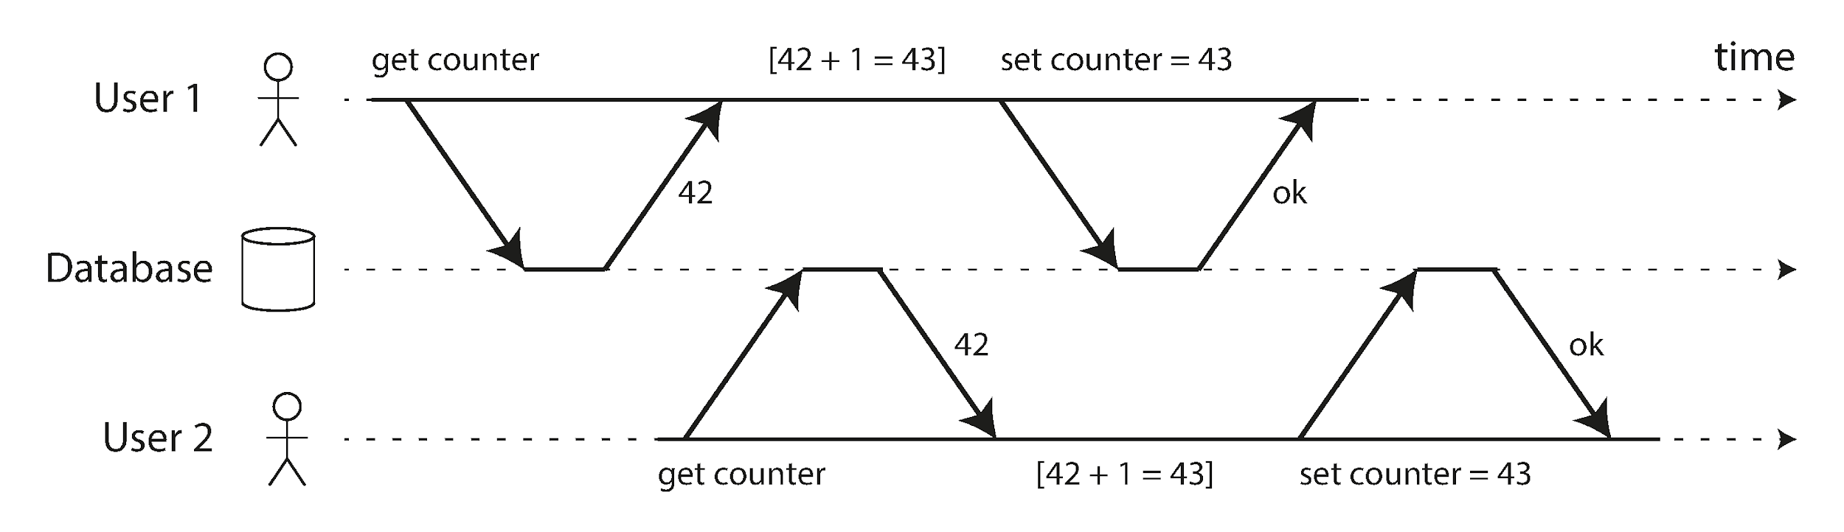
Lost Update Hazard
Classic counter increment race (Figure 7‑1)
Read‑modify‑write cycle without locking → correctness bug
Neither reader sees other’s write ⇒ one increment lost`
Notes:
Figure 7‑1, reproduced on this slide, shows two users each trying to add one to the same counter. Both perform a *read*, calculate `+1`, and *write* back. Because the operations interleave, the second write clobbers the first and the counter ends up at 43, not 44.
Even seasoned engineers get bitten by this in Redis or Cassandra because the race is invisible in unit tests—it only manifests under concurrency. The fix is to treat the increment as **one atomic statement** or to introduce an explicit lock. Later we will see how various isolation levels handle (or fail to handle) this anomaly.
Walk the diagram left‑to‑right with the audience: each arrow is a network round‑trip, the dashed line is time, and you can watch the state diverge in real‑time until the final commit makes the incorrect value durable.

Slide 5
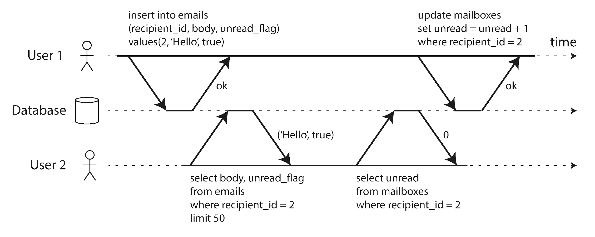
Dirty Read Example
Tx A writes email + unread‑counter (Figure 7‑2)
Tx B reads *uncommitted* email row ⇒ inconsistency
Read Committed isolation blocks this hazard
Notes:
Dirty reads violate the intuition that “if I can read it, it must be real.” In Figure 7‑2 User 1 inserts a mail row and intends to increment the unread counter, but before the commit happens User 2’s query picks up the half‑finished state. The UI now shows one unread message **and** an unread count of zero—confusing and potentially dangerous if business logic runs on that information.
Projects sometimes drop to **Read Uncommitted** or disable transactions for performance and then spend months chasing bugs like these. The takeaway: at *minimum* you want **Read Committed**, which hides uncommitted data by default. Notice how the figure shows User 2 only seeing `(Hello, true)` before the counter update, demonstrating exactly what the hazard looks like in SQL traffic captures. We will shortly unpack how read locks or versioning accomplish this.

Slide 6
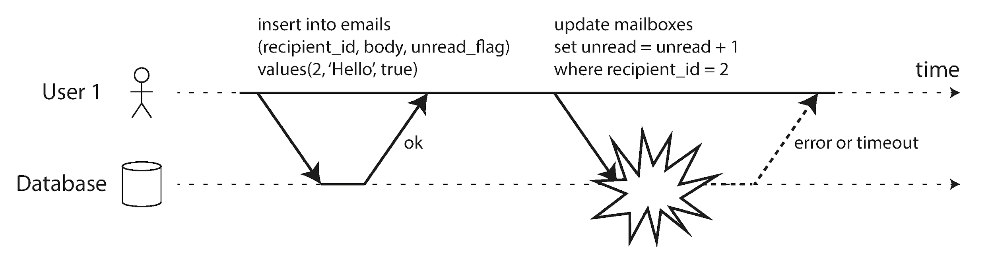
Atomicity Failure
Error mid‑transaction → exposed partial state (Figure 7‑3)
Rollback restores invariants; App simply retries
Notes:
Figure 7‑3 illustrates a write that fails halfway through—perhaps disk full or a unique constraint trips. Without transactions you could be left with the new email row inserted but the unread counter still wrong. To repair you would need ad‑hoc scripts and great bravery at 3 a.m.
With atomicity the database discards the entire batch the moment any statement errors. In code that means catching an exception and issuing the same logical transaction again. That simplicity is why veteran engineers get nervous the minute they hear “we disabled transactions for speed.”

Slide 7
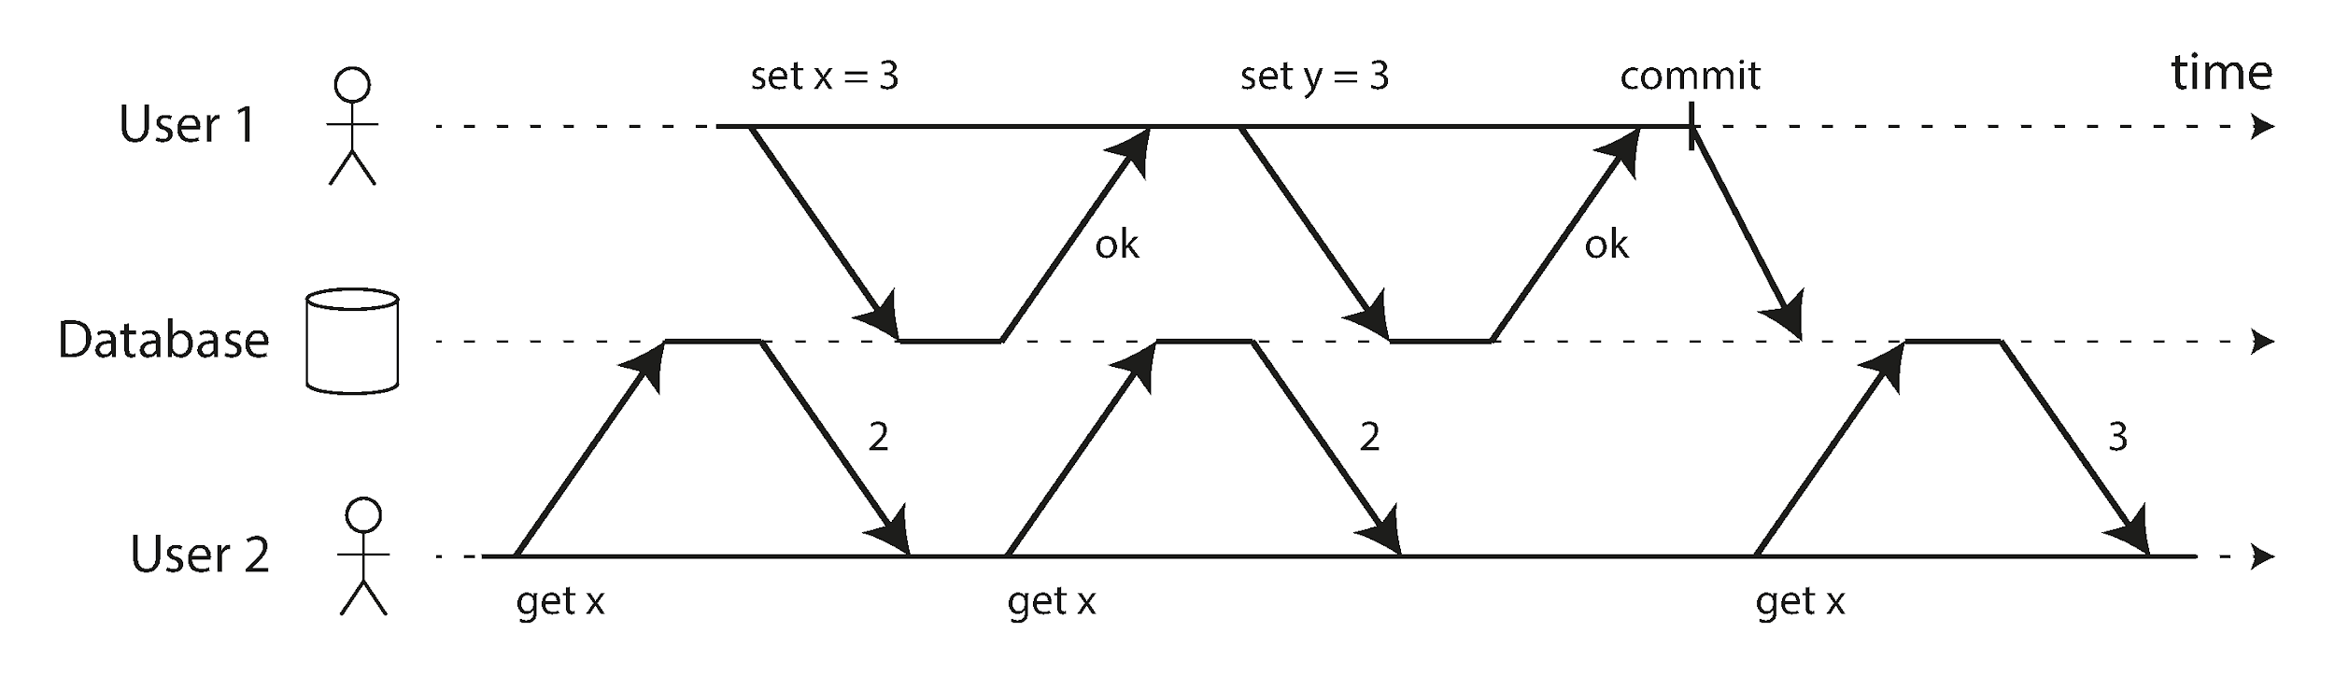
Read Committed Isolation
Guarantees: no dirty reads, no dirty writes
Allows non‑repeatable reads / read skew
Implemented via row‑level locks + old/new versions (Fig 7‑4)
Notes:
Read Committed is the default level in PostgreSQL, Oracle and SQL Server. The animation in Figure 7‑4 shows why. User 1 sets `x = 3` but holds the transaction open; User 2 issues two `SELECT x` calls—first sees 2 (old committed value), later 3 (new committed value). The guarantee is that **nothing uncommitted leaks** and writers never overwrite uncommitted data.
Internally the database takes an exclusive row lock for writes, and either uses a short shared lock for reads OR, more commonly, keeps the previous committed version in an MVCC structure so readers are never blocked. That principle—writers don’t block readers—is crucial for OLTP latency.

Slide 8
Read Committed Under the Hood
Row locks protect against dirty writes
Readers get *previous* committed version (MVCC)
Lock contention still possible → latency spikes
Notes:
Let’s peek beneath the covers. On any `UPDATE`, InnoDB or Postgres first acquires an **exclusive row lock**—other writers and sometimes readers must wait. The old values are copied to the undo log, creating a time‑travel snapshot. Readers walking the table pointer chase back to the first version that was already committed when their statement began.
The benefit is clear: your analytics query can run for minutes without blocking inserts. However, long‑running writers *do* block other writers, and under high write skew you can see queueing delays. Monitoring lock wait time is therefore a key operational metric in RC deployments.

Slide 9
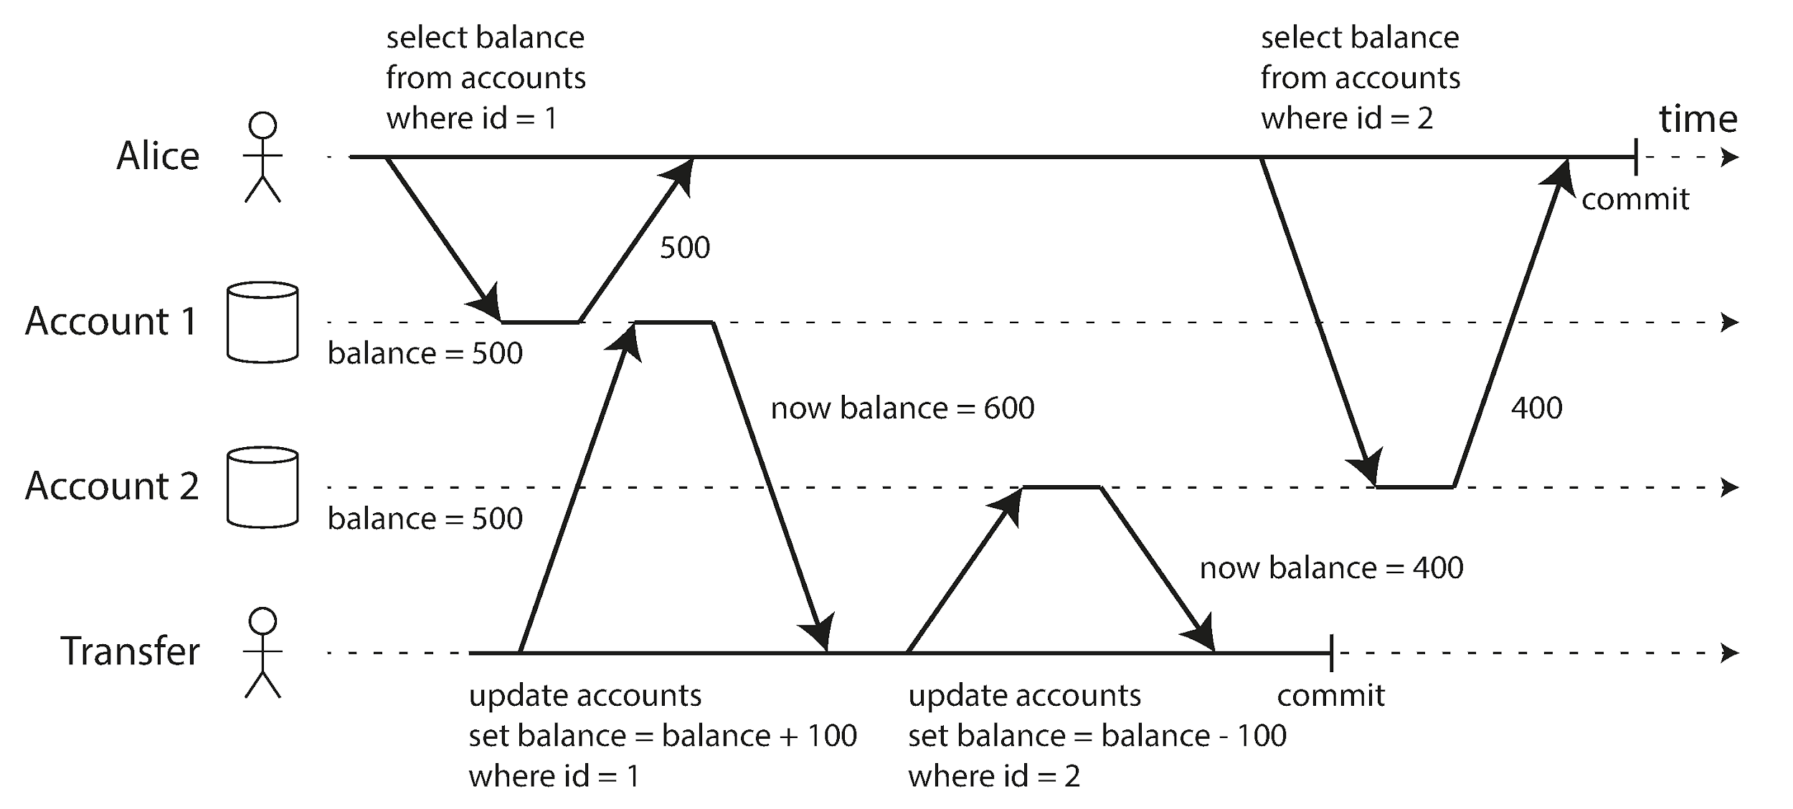
Snapshot Isolation Basics
Tx reads from stable snapshot taken at BEGIN
Prevents read skew (Fig 7‑6) + supports long reads
Mantra: *Readers ⟂ Writers* — via MVCC
Notes:
Snapshot Isolation—often mis‑named *Repeatable Read*—freezes the entire database image at the moment `BEGIN` executes. Figure 7‑6 shows Alice’s two accounts: a transfer moves $100, but because her `SELECT` runs on one snapshot she momentarily sees $500 + $400 = $900, a violation of invariant, illustrating **read skew**.
With SI, every row version carries `created_by` and `deleted_by` transaction IDs (TIDs). A transaction’s visibility rules consider any TID >= its own start as “in the future” and therefore hidden. The arrangement is perfect for backups and analytical queries because they can stream from a coherent point‑in‑time without blocking writers.

Slide 10
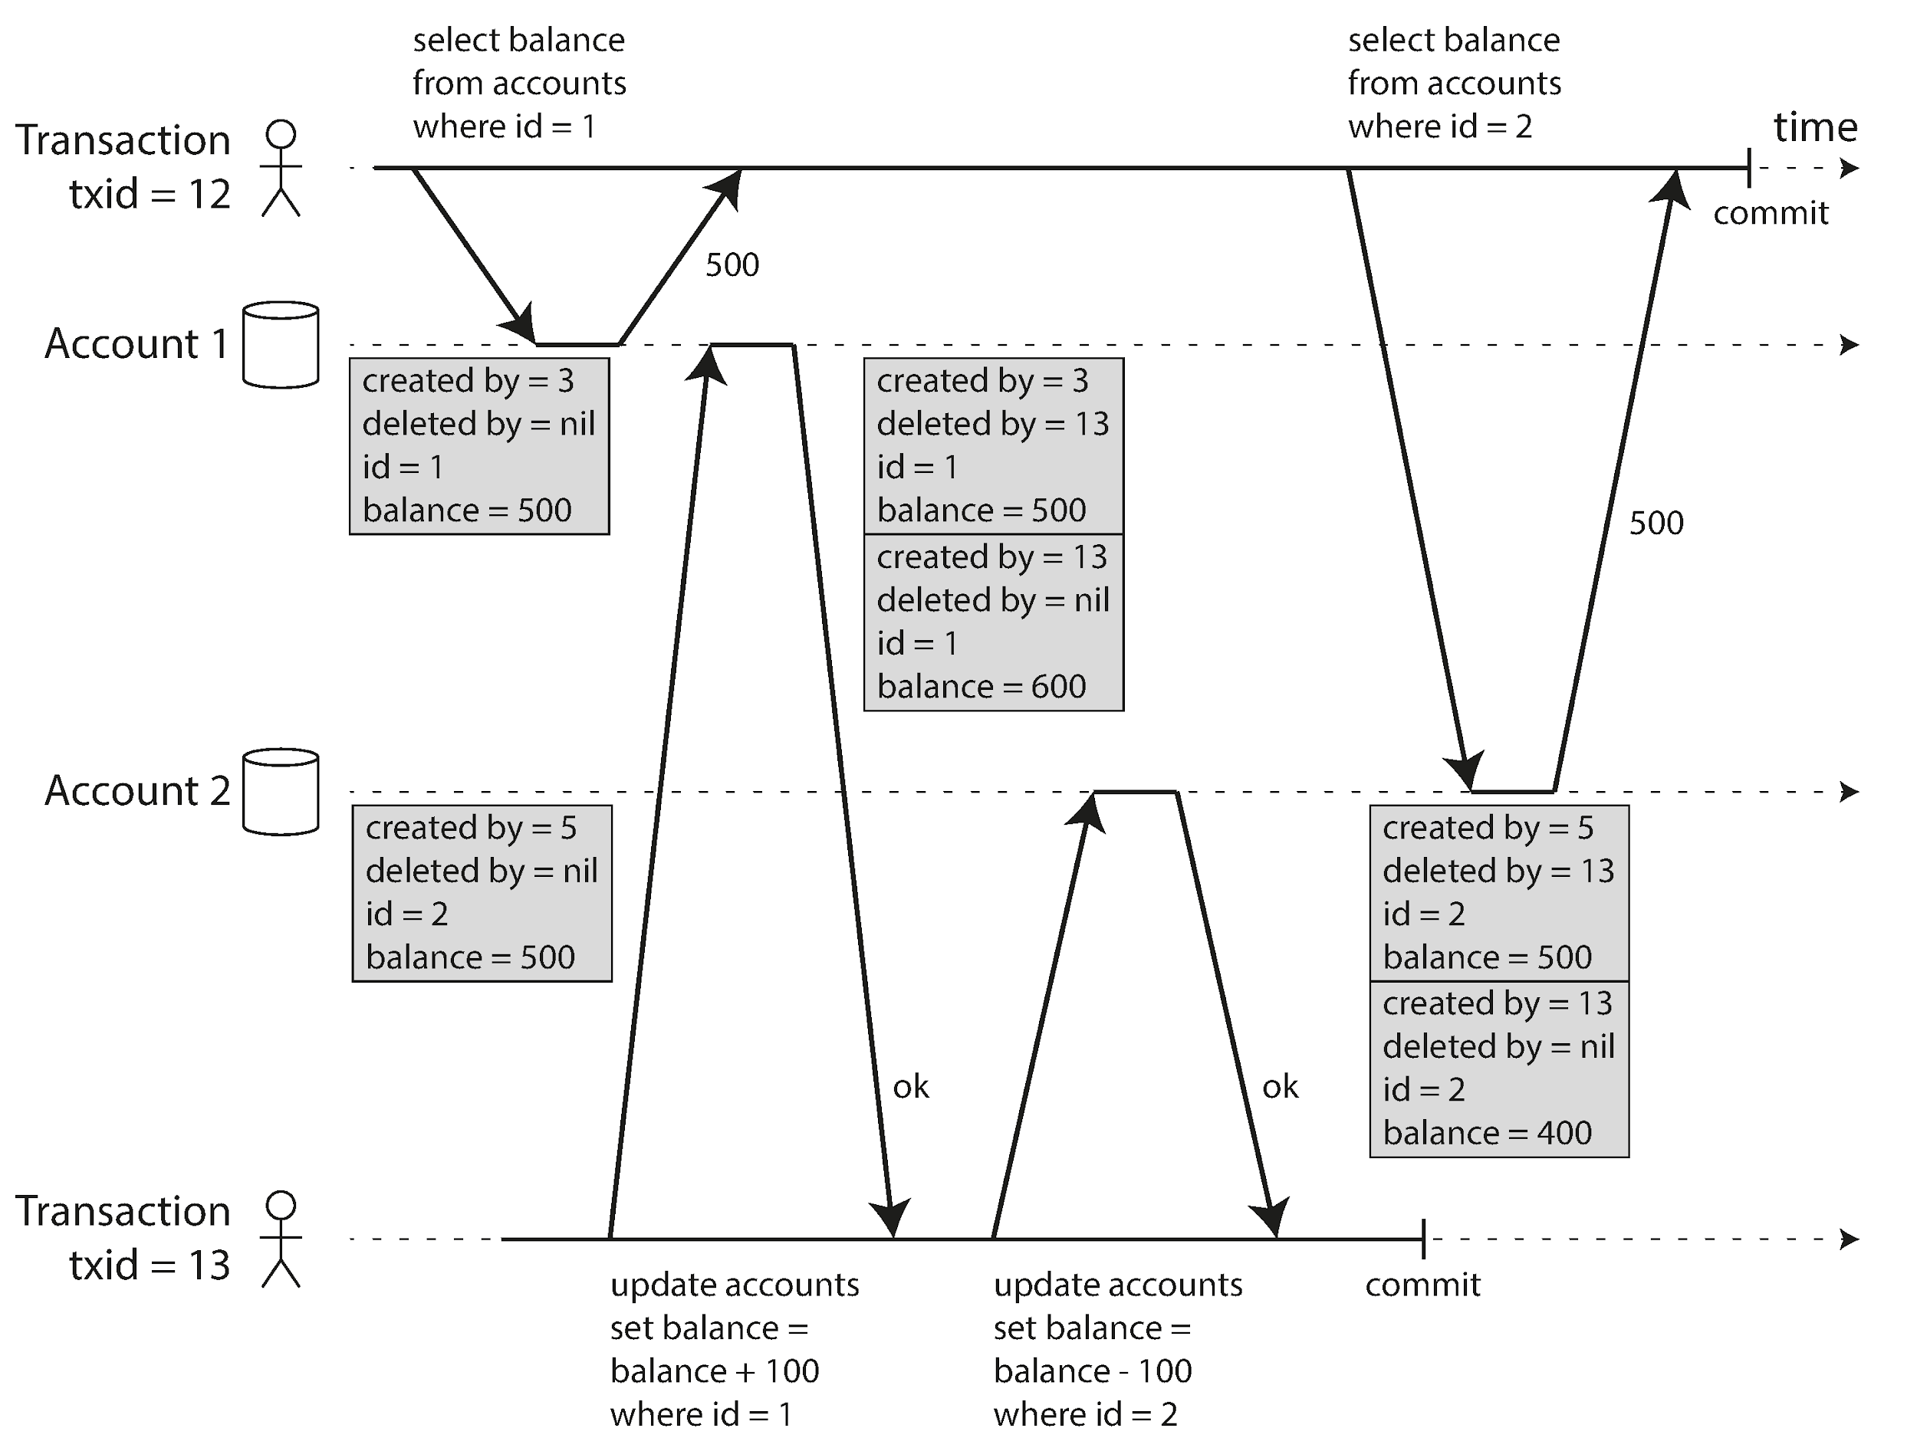
MVCC in Action
Multiple row versions stored side‑by‑side (Fig 7‑7)
Visibility rules decide which version each Tx sees
Background vacuum/GC reclaims obsolete versions
Notes:
Figure 7‑7 (rendered here) visualises PostgreSQL’s MVCC table layout. Each logical row might have a **chain of versions**. When Tx 12 starts it notes the list of in‑flight transactions. Any row created by a TID on that list is invisible; any row whose `deleted_by` is still in‑flight is still visible.
When Tx 13 updates Account 2 the engine physically inserts a *new* row, marks the old row’s `deleted_by`, and continues. Over time a *vacuum* process determines that no running transaction can ever see the old version and frees the space. The key message for operators: MVCC means your disk usage grows with update rate, so plan autovacuum aggressively!

Slide 11
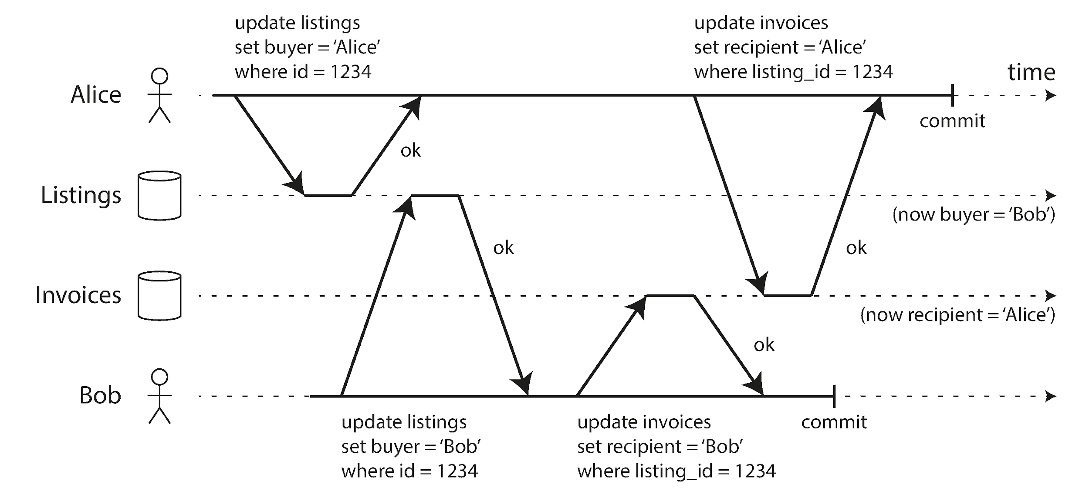
Lost Update via Conflicting Writes
Two writers update different columns in same row (Fig 7‑5)
Read Committed allows → mixed data state
Solutions: atomic ops, explicit locks, or higher isolation
Notes:
In Figure 7‑5 Alice buys the car in the `listings` table while Bob is simultaneously invoiced. Each transaction updates a different column, so row‑level locking does not help—both write operations succeed and you end up with *Bob owns the car but Alice paid for it*! This is a **lost‑update** expressed across two tables.
Strategies:
1. Collapse the operation into one atomic stored procedure that touches both rows under a stronger isolation level.
2. Add an **application lock** using `SELECT … FOR UPDATE`.
3. Redesign the schema to make the invariant enforceable with a single unique constraint.
A quick fix is to raise the isolation level to Serializable, but that may hurt throughput, leading us to the forthcoming algorithms.

Slide 12
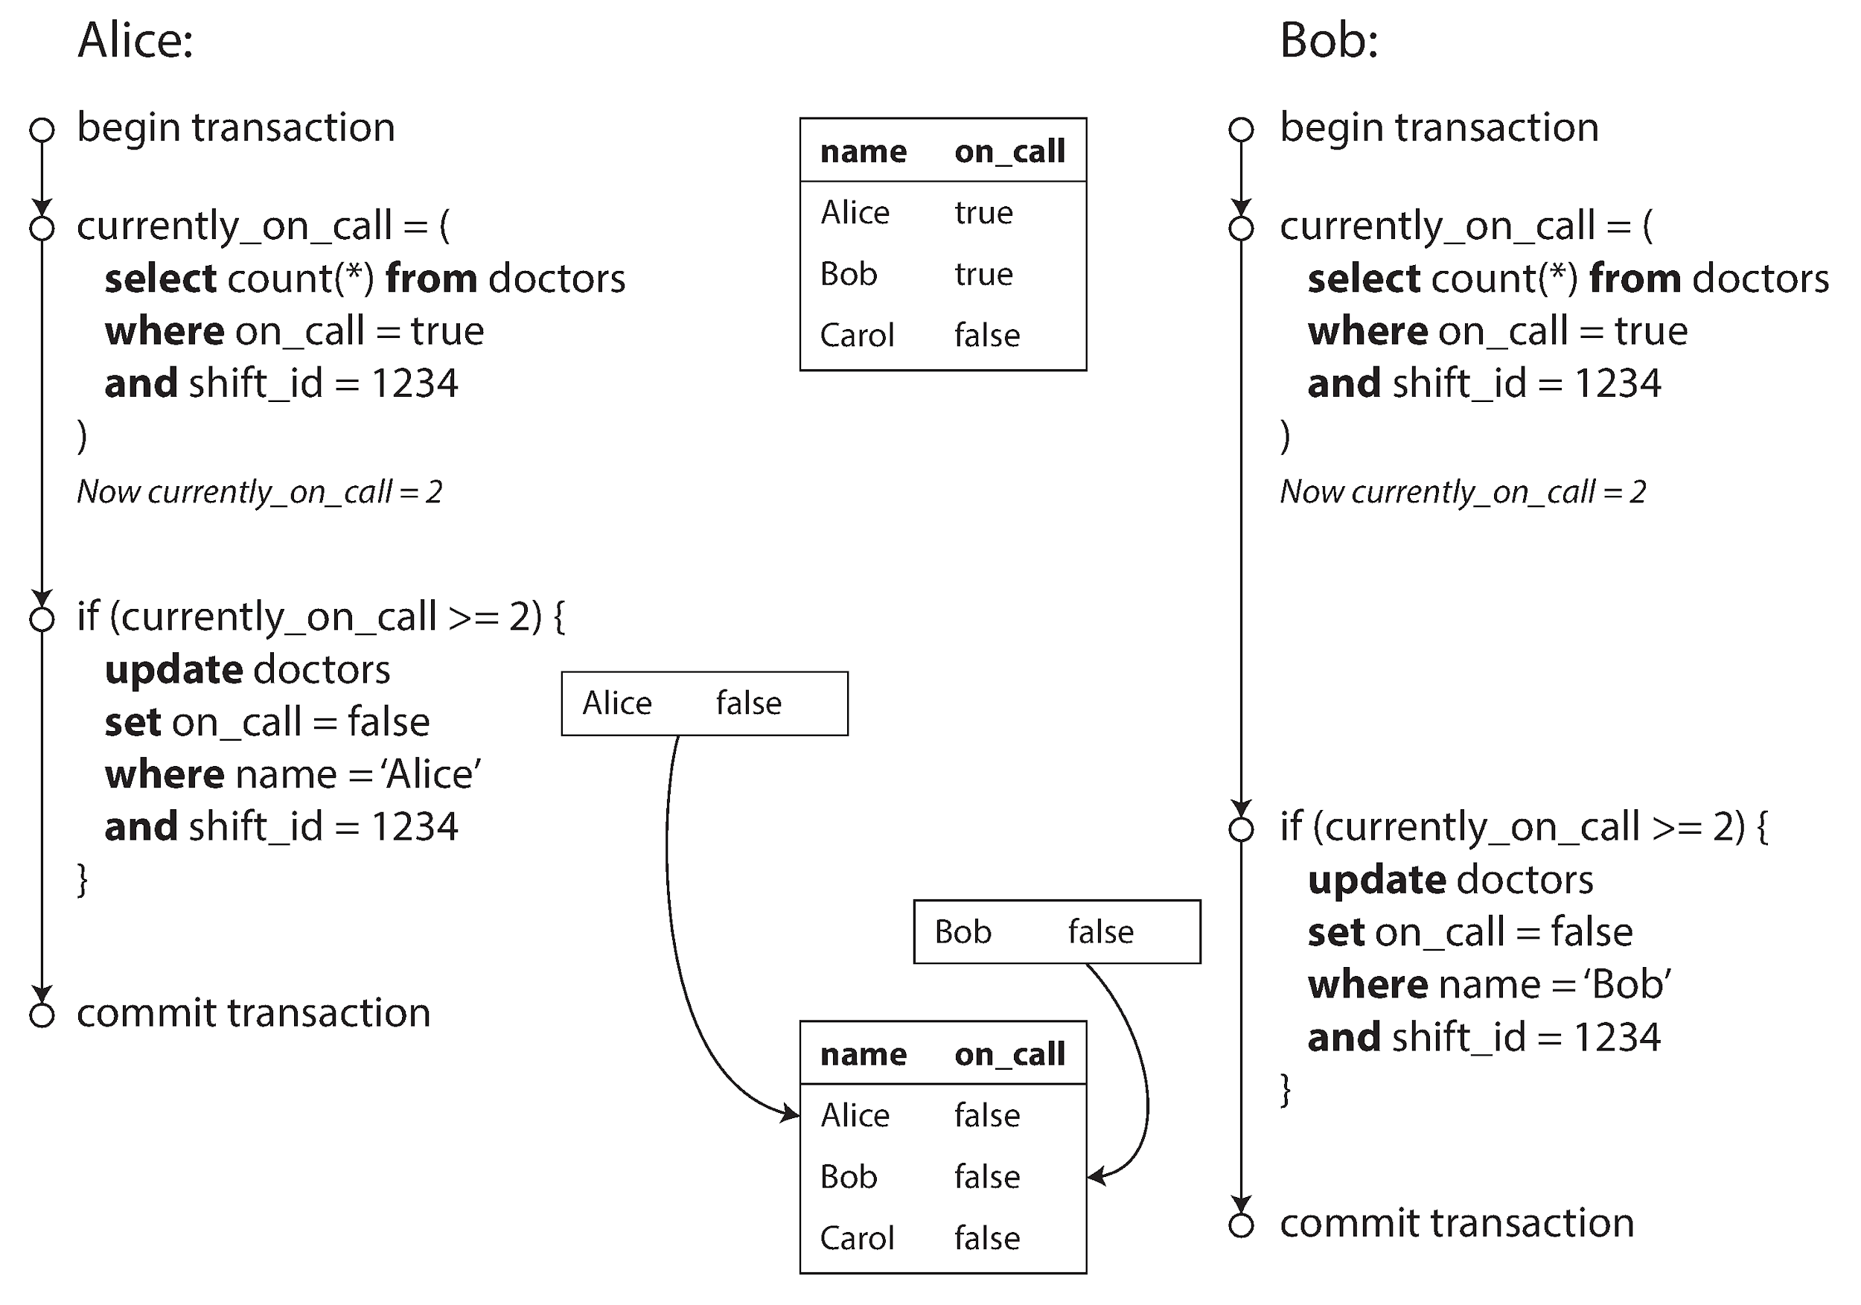
Write Skew & Phantoms
Two Tx read same predicate then write *disjoint* rows (Fig 7‑8)
Each premise valid in isolation ⇒ combined state invalid
Snapshot Isolation vulnerable → need Serializable
Notes:
Perhaps the most devious anomaly is **write skew**. The doctors‑on‑call scenario is perfect: both Alice and Bob check that at least two doctors are currently on duty. Each sees 2, decides it is safe to go off call, and updates *their own* row. The commits interleave such that both exits succeed and zero doctors remain—a violation of hospital policy.
Notice that neither lost an update nor read uncommitted data. The root cause is that the transactions made decisions based on a **predicate** (“count ≥ 2”) that was jointly invalidated. These phantom rows appear between the predicate read and the commit.
If your business rules include “at least N” style conditions, Snapshot Isolation is not enough. You either add manual predicate locks or move to full serializability, which we discuss next.

Slide 13
Preventing Anomalies
Atomic ops (increment, compare‑and‑set) for single keys
Explicit locks (`SELECT … FOR UPDATE`) around predicates
Conflict detection + retry under Snapshot Isolation
Notes:
Before we throw heavyweight serializability at every workload, it is worth cataloging cheaper options.
*Atomic operations* are perfect when your invariant is “counter plus one” or “append to this set.” Many document and key‑value stores offer these with no locking.
For cross‑row logic you can fall back to **pessimistic locks**—grab the rows you just read, keep the lock through commit. This is safe but may destroy latency under contention.
Modern engines like Postgres add **optimistic lost‑update detection**: if another transaction has touched the row since you read it the commit fails automatically. No lock, but you must handle the retry path explicitly. Combine this with exponential back‑off to avoid overload spirals.

Slide 14
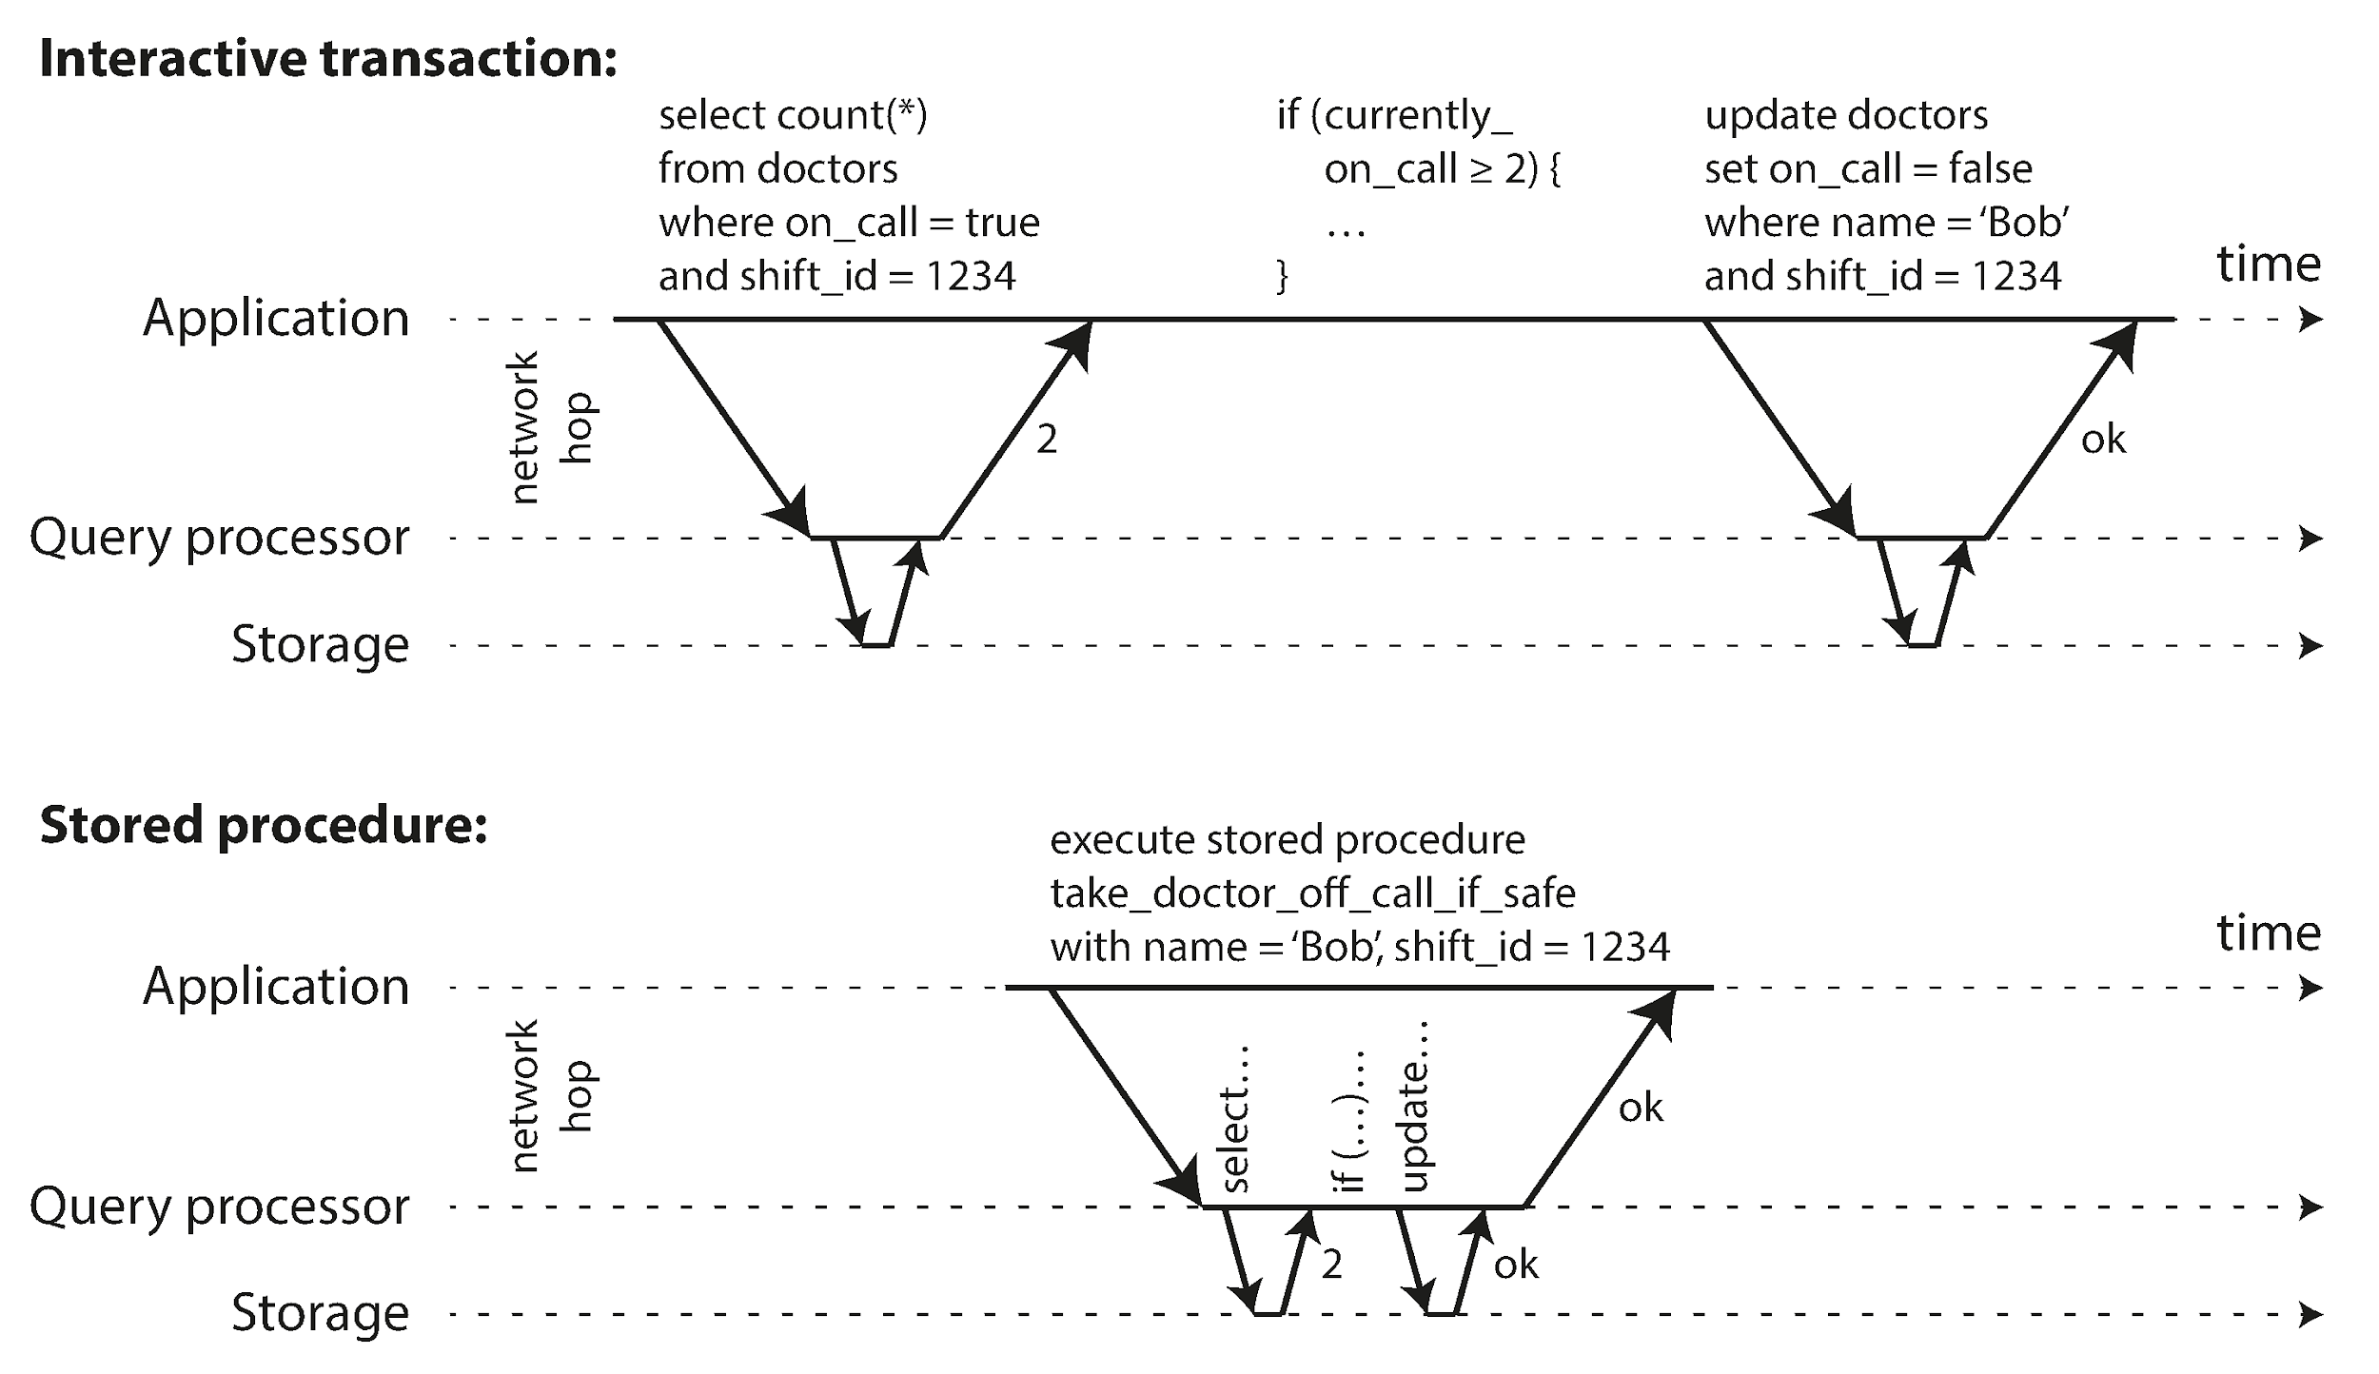
Serial Execution Model
Run Tx one‑at‑a‑time on single thread (VoltDB, Redis)
Achieves serializability by definition
Constraints: all data in RAM, small & fast Tx, partitioning for scale (Fig 7‑9)
Notes:
An elegant yet under‑appreciated idea is: stop fighting concurrency and remove it! Systems like VoltDB, H‑Store and Redis pipeline all write transactions through a single event loop per core. Figure 7‑9 contrasts the traditional client‑server “chatty” style with a pre‑registered **stored procedure** that runs to completion entirely inside the database process.
Pros: no locks, no MVCC bookkeeping, and thus predictable microsecond latency. Cons: you cap throughput at one core unless you can **partition** perfectly so each piece of data is owned by exactly one core. Cross‑partition transactions fall back to two‑phase commit and lose those latency advantages. Still, for tightly‑sharded gaming or ad‑tech workloads this model shines.

Slide 15
Two‑Phase Locking (2PL)
Traditional pessimistic serializability algorithm
Locks in shared / exclusive modes; release only at COMMIT
Readers block writers & vice‑versa → latency spikes
Index‑range (next‑key) locks prevent phantoms (Fig 7‑11)
Notes:
Invented in the 1970s, 2PL dominated the database landscape for decades. The rules are simple: before any read or write the transaction acquires the appropriate lock; once it releases *any* lock it may acquire no new locks—hence two phases. Because locks are held until commit, competing transactions block, and deadlocks are inevitable. Engines detect cycles and abort a victim, meaning your application must retry.
While robust, 2PL often exhibits the worst tail‑latency under write‑heavy loads, which pushed vendors to explore optimistic techniques.

Slide 16
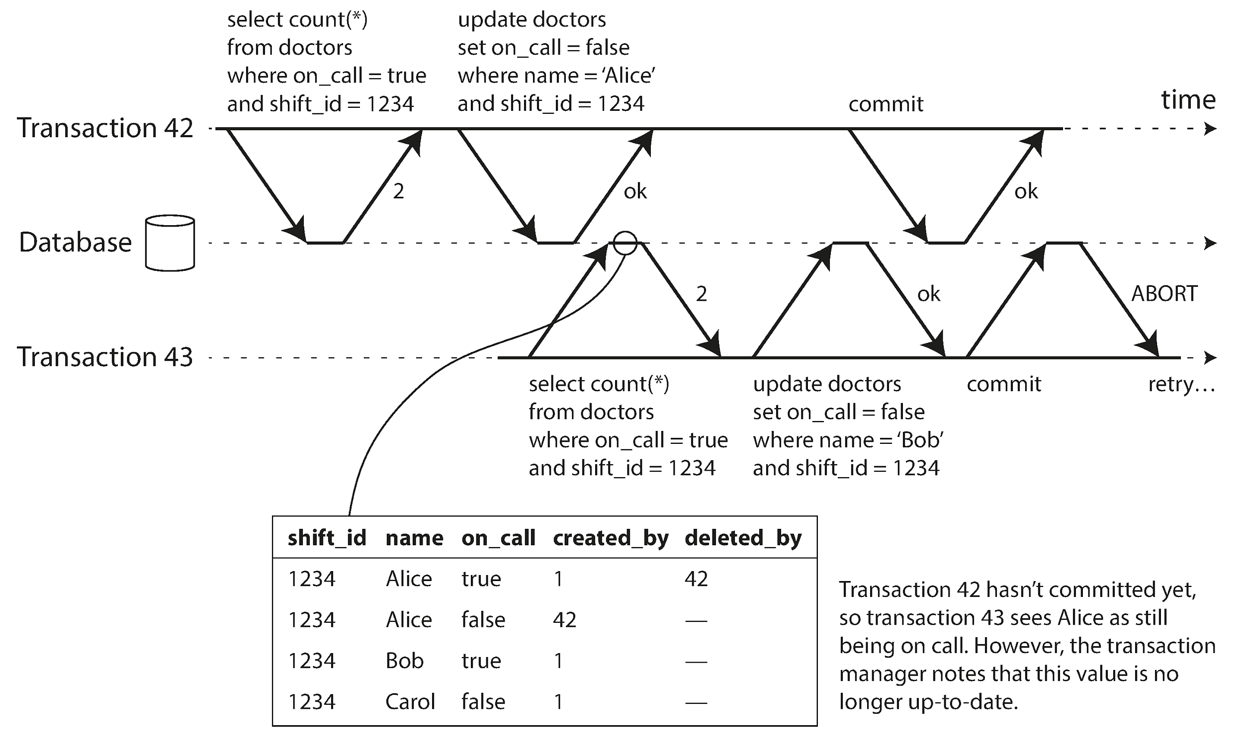
Serializable Snapshot Isolation
Optimistic algorithm: allow, then detect conflicts (Fig 7‑10)
Tracks read & write sets via lightweight locks
On dangerous cycle → abort + retry
In Postgres ≥ 9.1; foundation of modern distributed DBs
Notes:
Michael Cahill’s 2008 research resulted in **Serializable Snapshot Isolation (SSI)**, now shipping in Postgres and FoundationDB. The engine lets every transaction run on its own snapshot, just like SI, but records two kinds of edges: “T2 read a version T1 later replaced” and “T1 wrote a key in T2’s predicate.” If those edges form a *dangerous cycle* the second committer is aborted.
Figure 7‑10 shows a stale MVCC read; Figure 7‑11 (next slide) shows a write affecting a prior read. SSI turns these patterns into a simple rule: if both happen, serialization would be violated, so roll back. Because the check happens only at commit time, readers never block writers and vice versa, giving near‑SI performance with full serializability.

Slide 17
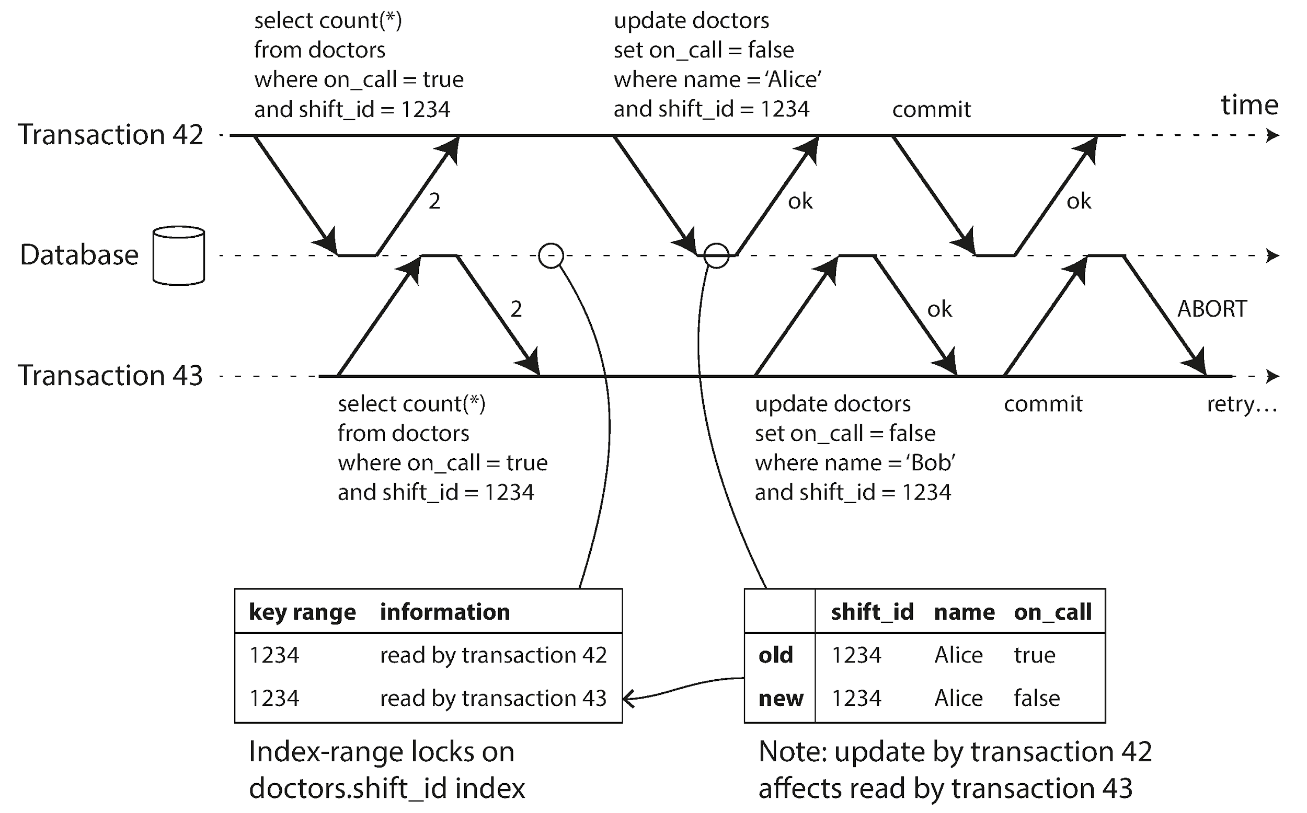
SSI Conflict Example
Tx 42 & Tx 43 form dangerous cycle (Fig 7‑11)
First committer wins; second aborts, client retries
Predictable latency; abort rate rises only under contention
Notes:
Building on the previous slide, here is the complete conflict. Both transactions counted on‑call doctors then each updated one row. The SSI book‑keeper attached invisible index‑range locks to the predicate `shift_id = 1234`. When Tx 42 writes it marks “I changed something Tx 43 read.” Vice versa for Tx 43. The second commit notices the cycle and aborts.
In practice abort rates are usually under 1 % except in synthetic benchmarks that hammer the same rows. For workloads dominated by *reads* SSI gives you serializable safety at roughly the price of snapshot isolation—a huge win compared to 2PL.

Slide 18
Summary & Takeaways
Choose isolation level consciously—defaults differ!
Dirty reads, lost updates, write skew cost real money
Serializable ≠ slow: SSI & partitioned serial execution
Use atomic ops / locks tactically when full Tx too heavy
Notes:
Let’s wrap. First, never accept a default isolation level without understanding its guarantees; the difference between Read Committed and Serializable is the difference between “may lose $100” and “cannot.”
Second, the anomalies we traced—dirty read, lost update, write skew—are not theoretical. They have tanked trading systems, produced duplicate invoices, and deleted customer data.
Third, performance is no longer a reason to reject serializability out‑of‑hand. VoltDB shows one core can handle hundreds of thousands of tx‑per‑second; Postgres SSI delivers serializability with single‑digit overheads.
Finally, be pragmatic. Single‑row atomic operations and explicit predicate locks are surgical tools. Use them to keep the hot path simple while pushing complex, correctness‑critical workflows onto transactional rails.

Slide 19
Questions & Discussion
Where could write skew lurk in *your* codebase?
Which Tx patterns hit your hot partitions today?
How would you test an application for lost updates?
Notes:
Thank you for staying with me through a fast tour of Chapter 7. I hope the figures and live examples fired some ideas about how transactions interact with real‑world engineering.
To kick off discussion I’ve listed three prompts, but please feel free to take us in any direction—war stories, architectural debates, or feature requests for your favorite database. Nothing beats learning from concrete examples, so if you have a bug you recently fixed, we’d love to dissect it together.
I’ll keep the figures handy in case we need to jump back to any scenario. Microphones are open!

